Slide 1
Conditionals and
Iterations

Slide 2
The modulus operator
The modulus operator works on integers (and integer expressions) and yields the remainder when the first operand is divided by the second.
In Python, the modulus operator is a percent sign (%).

Slide 3
Example
The syntax is the same as for other operators:
>>> quotient = 7 / 3
>>> print quotient
2
>>> remainder = 7 % 3
>>> print remainder
1
So 7 divided by 3 is 2 with 1 left over.

Slide 4
Uses
Check whether one number is divisible by another if x % y is zero, then x is divisible by y.
you can extract the right-most digit or digits from a number.
For example,
x % 10 yields the right-most digit of x (in base 10). Similarly x % 100 yields the last two digits.

Slide 5
Boolean expressions
A Boolean expression is an expression that is either true or false.
One way to write a Boolean expression is to use the operator ==, which compares two values and produces a Boolean value:
>>> 5 == 5
True
>>> 5 == 6
False
True and False are special values that are built into Python.

Slide 6
Comparison Operators
x != y # x is not equal to y
x > y # x is greater than y
x < y # x is less than y
x >= y # x is greater than or equal to y
x <= y # x is less than or equal to y
NOTE: “= is an assignment operator and == is a comparison operator”. Also, there is no such thing as =< or =>.

Slide 7
Logical operators
There are three logical operators:
        and,
        or
        not
For example, x > 0 and x < 10 is true only if x is greater than 0 and less than 10.
n%2 == 0 or n%3 == 0
not(x > y) is true if (x > y) is false, that is, if x is less than or equal to y.

Slide 8
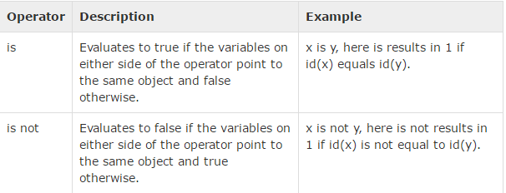
Identity operators
Identity operators compare the memory locations of two objects. There are two Identity operators as explained below

Slide 9
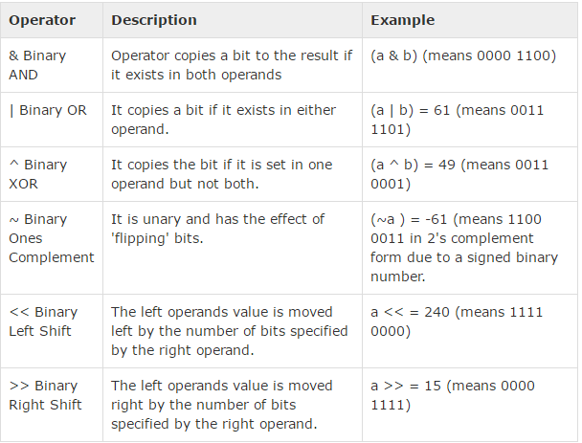
Bitwise Operators
Notes:
a = 60 and b = 13, a = 0011 1100 and b = 0000 1101

Slide 10
Keyboard Input
input(): built in function to get data from keyboard.
Takes data in the form of string.
Eg:
  >>> input1 = input ()
  What are you waiting for?
  >>> print input1
  What are you waiting for?
Before calling input, it is a good idea to print a message telling the user what to input. This message is called a prompt.
A prompt can be supplied as an argument to input.

Slide 11
Eg:
  >>> name = input ("What...is your name? ")
  What...is your name? Arthur, King of the Britons!
  >>> print name
  Arthur, King of the Britons!
If we expect the response to be an integer, then type conversion needs to be done.
Eg:
  prompt = "What is the airspeed velocity of an unladen swallow?"
  speed =int(input(prompt))

Slide 12
Conditional Execution
To write useful programs we need the ability to check conditions and change the behaviour of the program accordingly.
Different conditional statements in python are:
  IF
  IF ---Else (Alternative Execution)
  IF--- ELIF---- ELSE (Chained Conditionals)
  Nested Conditionals

Slide 13
If Condition
If x > 0:
print "x is positive“
The Boolean expression after the if statement is called the condition. If it is true, then the indented statement gets executed. If not, nothing happens.
Structure of If
  HEADER:
FIRST STATEMENT
...
LAST STATEMENT

Slide 14
If Condition
There is no limit on the number of statements that can appear in the body of an if statement, but there has to be at least one.
Occasionally, it is useful to have a body with no statements (usually as a place keeper for code you haven't written yet). In that case, you can use the pass statement, which does nothing.

Slide 15
Alternative Execution
A second form of the if statement is alternative execution, in which there are two possibilities and the condition determines which one gets executed.
Eg:
  if x%2 == 0:
  print x, "is even"
  else:
    print x, "is odd“
The alternatives are called branches.
Notes:
We all know YouTube as the place to upload cat videos and fails. As one of the most popular websites in existence, it provides us with endless hours of video entertainment. The Python programming language powers it and the features we love.

Slide 16
Continue….
Since the condition must be true or false, exactly one of the alternatives will be executed. The alternatives are called branches, because they are branches in the flow of execution.

Slide 17
Chained Conditionals
Sometimes there are more than two possibilities and we need more than two branches.
if x < y:
print x, "is less than", y
elif x > y:
print x, "is greater than", y
else:
print x, "and", y, "are equal“
NOTE: There is no limit of the number of elif statements, but the last branch has to be an else statement

Slide 18
Nested conditionals
One conditional can also be nested within another.
if x == y:
print x, "and", y, "are equal"
else:
if x < y:
print x, "is less than", y
else:
print x, "is greater than", y

Slide 19
if 0 < x and x < 10:
  print "x is a positive single digit.“
Python provides an alternative syntax that is similar to mathematical notation:
if 0 < x < 10:
print "x is a positive single digit."

Slide 20
Shortcuts for Conditions
Numeric value 0 is treated as False
Empty sequence "", [] is treated as False
Everything else is True
  if m%n:
    (m,n) = (n,m%n)
  else:
    gcd = n
Notes:
Survey Monkey is the largest online survey company. They can handle over one million responses every day on their rewritten Python.

Slide 21
Avoid Nested If
For example, We can rewrite the following code using a single conditional:
if 0 < x:
if x < 10:
print "x is a positive single digit.“
Better way:
if 0 < x and x < 10:
print "x is a positive single digit."

Slide 22
ITERATION

Slide 23
Doing the Same Thing Many Times
It’s possible to do something repeatedly by just writing it all out
Print ‘hello’ 5 times
>>> print('Hello!')
Hello
>>> print('Hello!')
Hello
>>> print('Hello!')
Hello
>>> print('Hello!')
Hello
>>> print('Hello!')
Hello
Count n
times
Statements

Slide 24
Iteration and Loops
A loop repeats a sequence of statements
A definite loop repeats a sequence of statements a predictable number of times
>>> for x in range(5): print('Hello!')
...
Hello
Hello
Hello
Hello
Hello
Count n
times
Statements

Slide 25
The for Loop
Python’s for loop can be used to iterate a definite number of times
for <variable> in range(<number of times>): <statement>
Use this syntax when you have only one statement to repeat
for <variable> in range(<number of times>):
<statement-1>
<statement-2>
…
<statement-n>
>>> for x in range(3):
... print('Hello!')
... print('goodbye')
...
Hello!
goodbye
Hello!
goodbye
Hello!
goodbye
Use indentation to format two or more statements below the loop header

Slide 26
Using the Loop Variable
The loop variable picks up the next value in a sequence on each pass through the loop
The expression range(n) generates a sequence of ints from 0 through n - 1
loop variable
>>> for x in range(5): print(x)
...
0
1
2
3
4
>>> list(range(5)) # Show as a list
[0, 1, 2, 3, 4]

Slide 27
Counting from 1 through n
The expression range(low, high) generates a sequence of ints from low through high - 1
>>> for x in range(1, 6): print(x)
...
1
2
3
4
5

Slide 28
Counting from n through 1
The expression range(high, low, step) generates a sequence of ints from high through low+1.
>>> for x in range(6, 1, -1): print(x)
...
6
5
4
3
2

Slide 29
Skipping Steps in a Sequence
The expression range(low, high, step) generates a sequence of ints starting with low and counting by step until high - 1 is reached or exceeded
>>> for x in range(1, 6, 2): print(x)
...
1
3
5
>>> list(range(1, 6, 2)) # Show as a list
[1, 3, 5]

Slide 30

While Loop
A for loop is used when a program knows it needs to repeat a block of code for a certain number of times.
A while loop is used when a program needs to loop until a particular condition occurs.

Slide 31
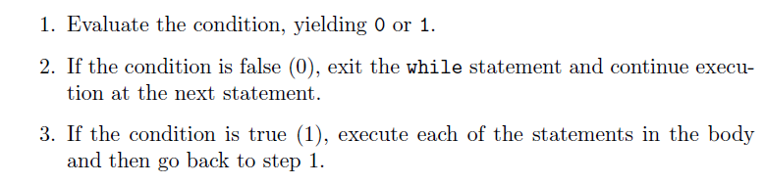
Flow of Execution for WHILE Statement

Slide 32

Looping Until User Wants To Quit

Slide 33
Range Function
Range returns an immutable sequence objects of integers between the given start integer to the stop integer.
range() constructor has two forms of definition:
  range(stop)
  range(start, stop, step)
    start - integer starting from which the sequence of integers is to be returned
    integer before which the sequence of integers is to be returned.
    The range of integers end at stop - 1.
      step (Optional) - integer value which determines the increment between each integer in the sequence

